Slide 1
STOCK MARKET ANALYSIS
GROUP-1
TEAM MEMBERS:
MR. ANKUSH A GOWDA
MR. AJAY KUMAR
MR. HARSHA S
MR. HEMANTH G P
MS. HEMALATHA SURARAPU
MR. NACHIN H C
MRS. RAJYALAKSHMI VYASABHAGAVAN
MR. SHUBHAM BHALERAO

Slide 2
BUSINESS PROBLEM
In stock market it is difficult for the traders to make a decision for TCS company he/she should invest based on the past value of the stock.

Slide 3
OBJECTIVE
The main aim of this project is to predict future stock prices of TCS company / whether the trader should invest in a stock or not.

Slide 4
DATA EXTRACTION
Data is about stock of the TCS.
It is extracted from NSE(national stock exchange).
The data we working form January 1st 2010 to current date.

Slide 5
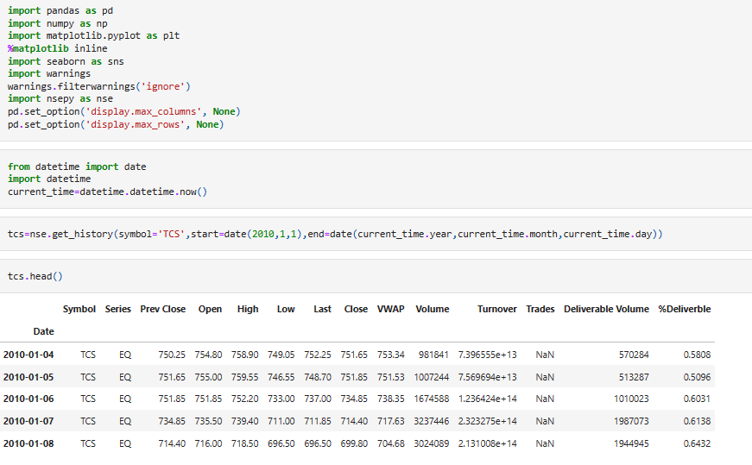
DATASET

Slide 6
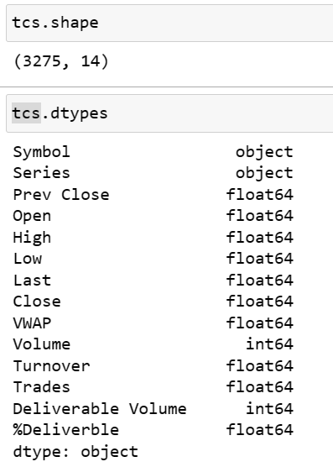
DATA PRE-PROCESSING
The data is about 14 variables and 3273 observations.
View the data types of the colum

Slide 7
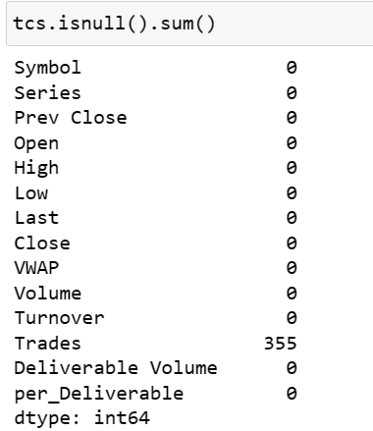
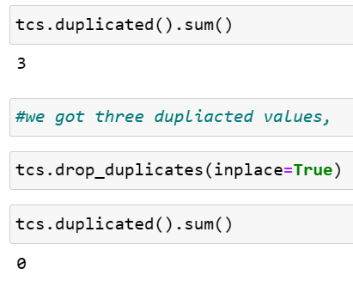
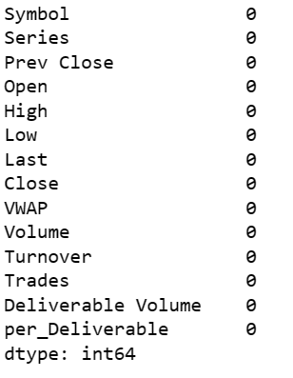
TREATING NULL VALUES AND DUPLICATES
By checking and imputing the null values in each features.
By checking and removing the duplicate va

Slide 8
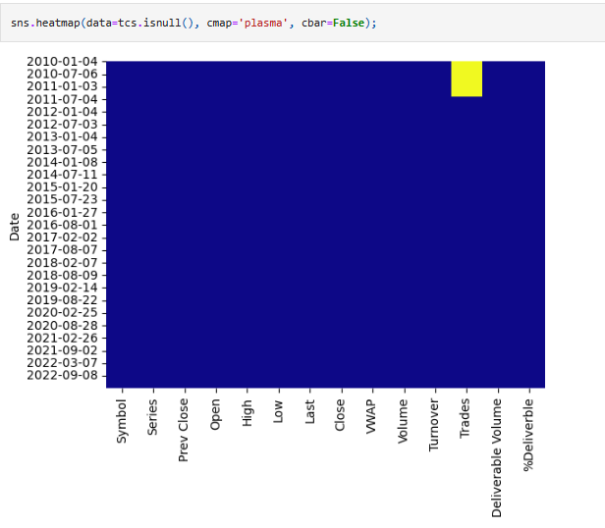
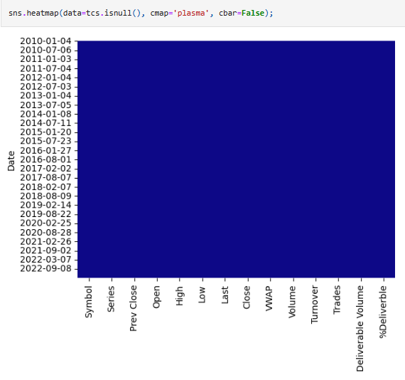
HEAT MAP FOR NULL VALUES
Yellow color indicates the null value existence.
If there is no null value yellow color is absent.

Slide 9
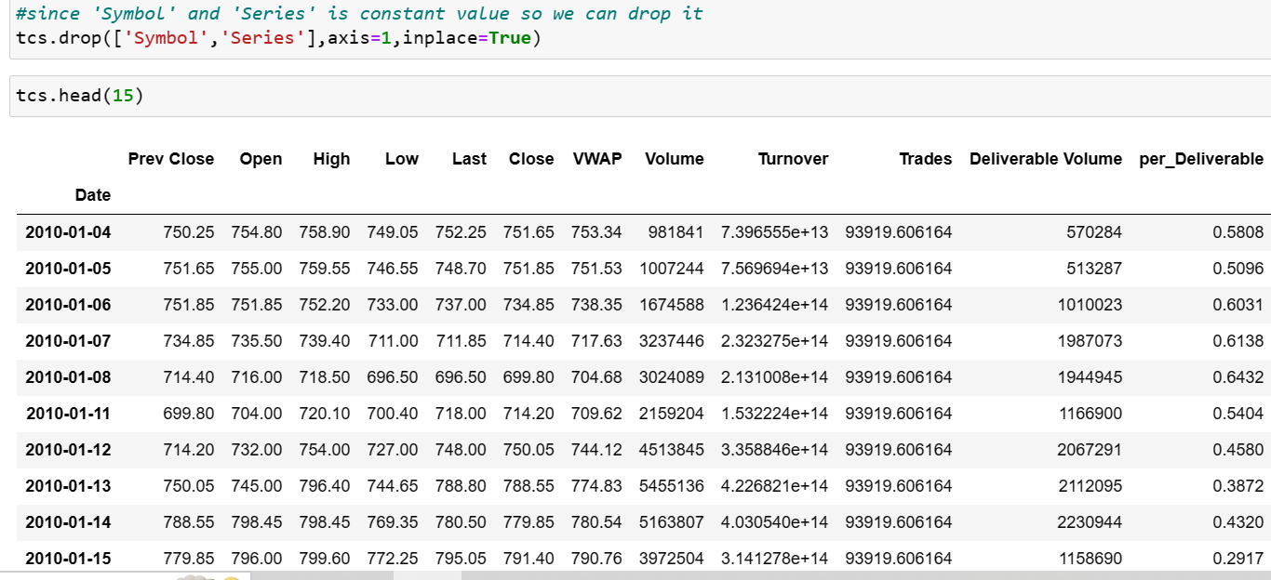
DATA PRE-PROCESSING
Dropping ‘symbol’ and ‘series’ column since, In these columns are having the same values throughout the data.

Slide 10
EXPLORATORY DATA ANALYSIS(EDA)
This data contains 12 variables (prev close, high, open, low, close, VWAP….)
Now we can explore various visualization to understand the data.

Slide 11
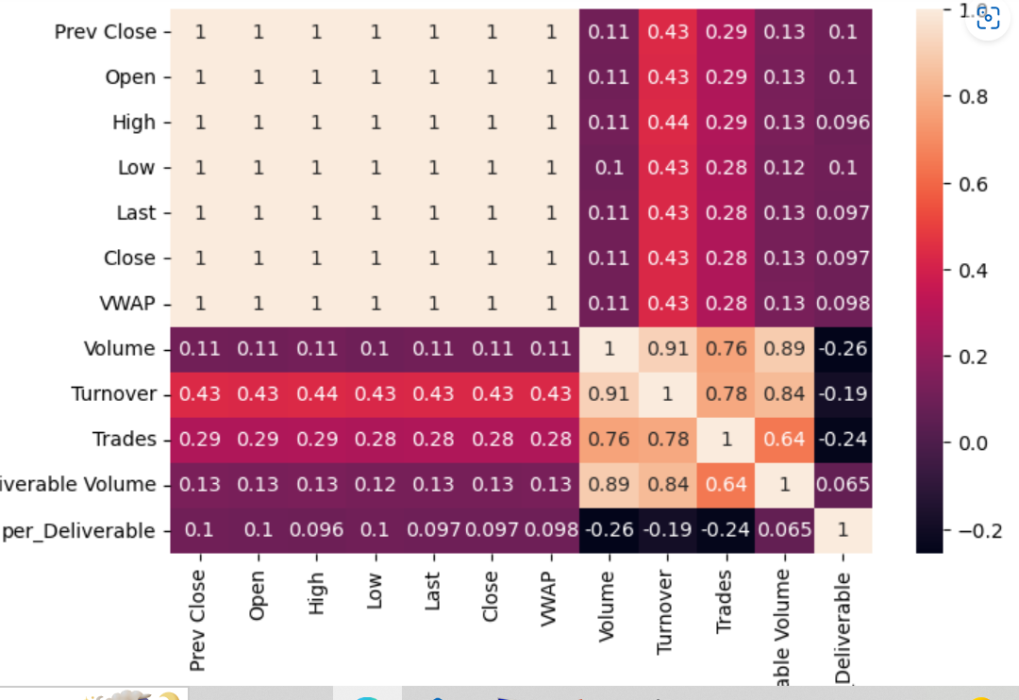
HEAT MAP FOR CORRELATION
we observe from scatter plot and heat map
Prev Close, open, High, Low, Last, Close, VWAP is highly co related with each other.
Volume is highly correlated with Turn over, Deliverable Volume.
Trades is moderately correlated with volume , Turnover , Deliverable volume
Deliverable Volume is highly co related with Volume , Turnover and moderately with Trades.
%Deliverable Volume is moderately co related with Deliverable Volume

Slide 12
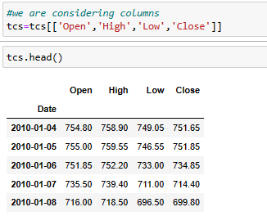
DATA PRE-PROCESSING
we are considering columns Open,High,Low,Close

Slide 13
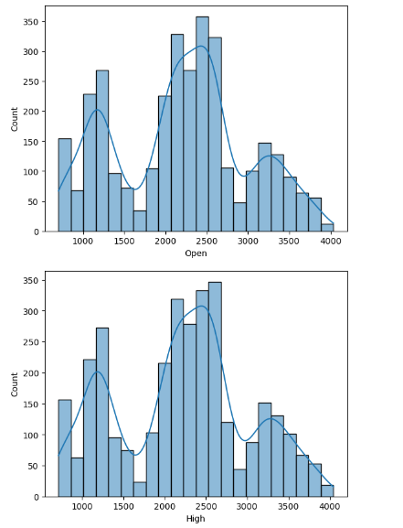
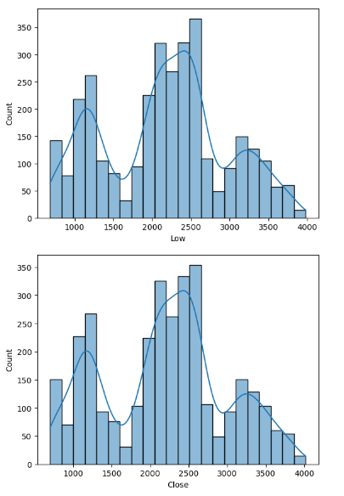
HISTOGRAM
Open,High,Low,Close is not normally distributed.

Slide 14
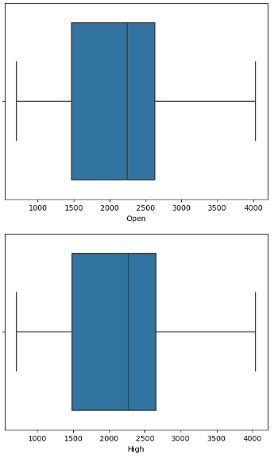
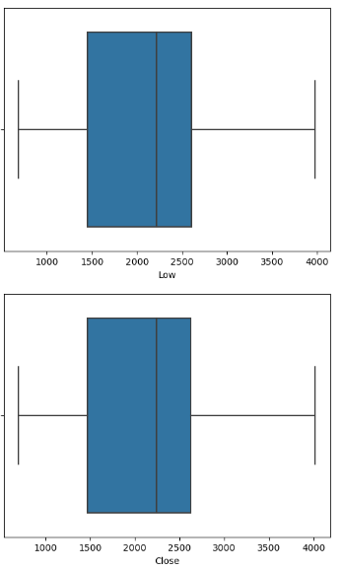
BOX PLOT
There are no outliers in Open,High,Low,Close.
.

Slide 15
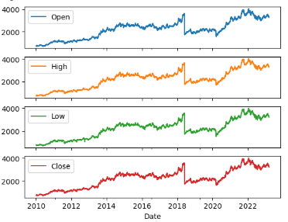
LINE PLOT
In Open,High,Low,Close we can see trend is increasing over the time.

Slide 16
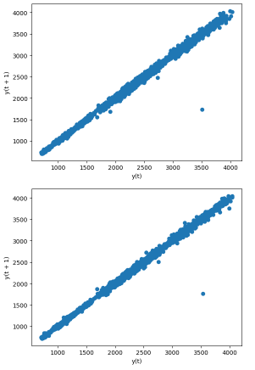
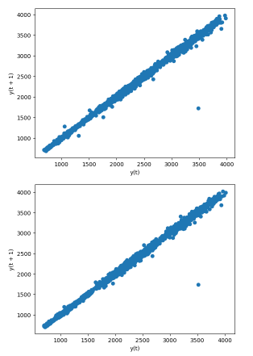
LAG PLOT
CLOSE
From lag_plot,we can visualize the autocorrelation structure of the time series data.
In Open,High,Low,Close feature it suggests a strong positive autocorrelation.

Slide 17
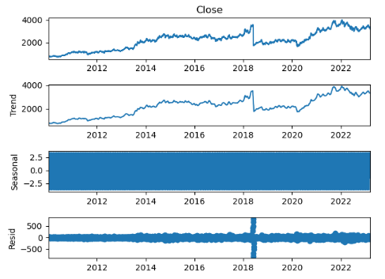
TIME SERIES DECOMPOSITION PLOT
From close Trend is increasing in close.
Seasonality ranges between -2.5 to 2.5
we see some residual

Slide 18
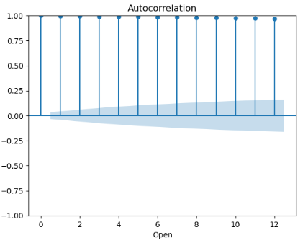
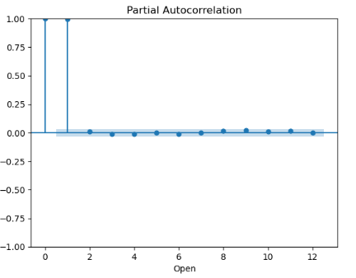
ACF & PACF PLOT FOR OPEN
Lag is constant in auto corelation and correlation is 1.
At lag=1 we see 1 is optimal correlation.

Slide 19
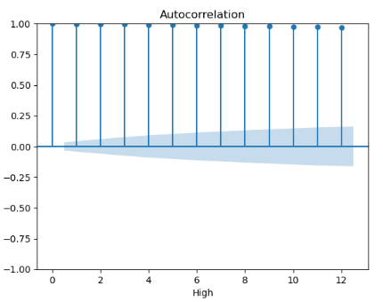
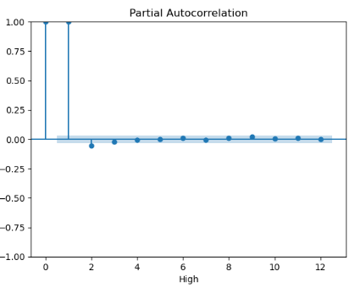
ACF & PACF PLOT FOR HIGH
Lag is constant in auto corelation and correlation is 1.
At lag=1 we see 1 is optimal correlation.

Slide 20
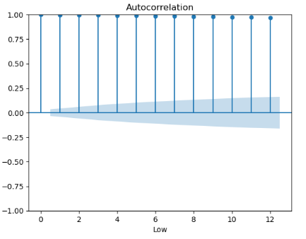
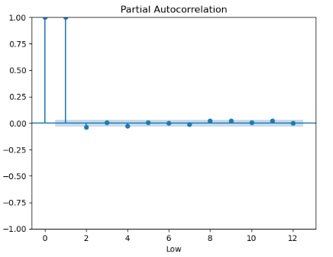
ACF & PACF PLOT FOR LOW
Lag is constant in auto corelation and correlation is 1.
At lag=1 we see 1 is optimal correlation.

Slide 21
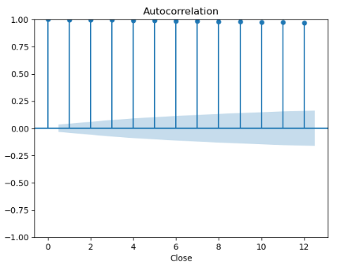
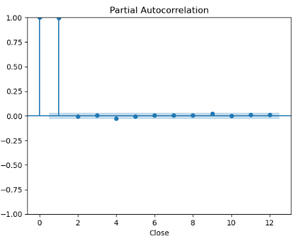
ACF & PACF PLOT FOR CLOSE
Lag is constant in auto corelation and correlation is 1.
At lag=1 we see 1 is optimal correlation.

Slide 22
PRE-PROCESSING
CHECKING STATIONARITY OF THE DATA
By performing augmented dicky fuller test(ADF).
At 95% confidence interval
if p-value < 0.05 data is stationary
if p-value > 0.05 data is not stationary

Slide 23
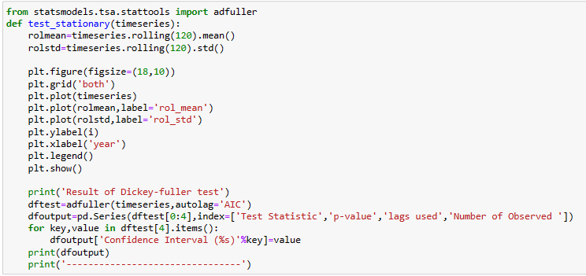
CHECKING STATIONARITY OF THE DATA
We are defining the code to check and plot stationarity of data.

Slide 24
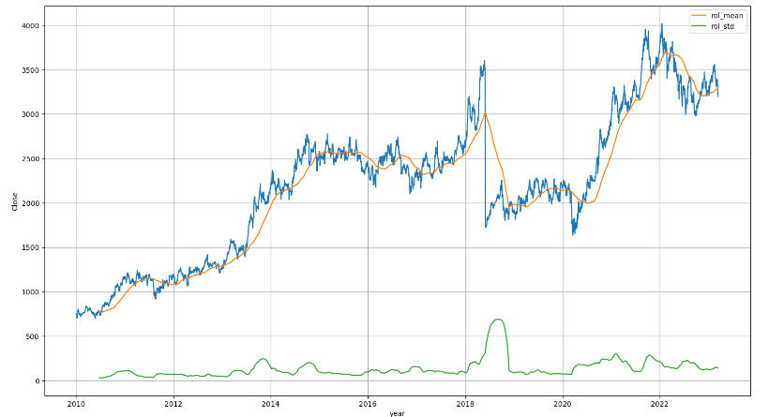
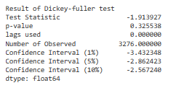
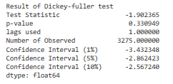
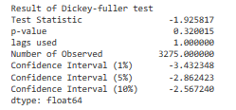
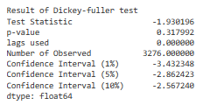
CHECKING STATIONARITY OF THE DATA
Without transforming the data Open,High,Low,Close,
We found the p-value greater than 0.05.Hence data is not stationary.
We cross verified by plotting it.

Slide 25
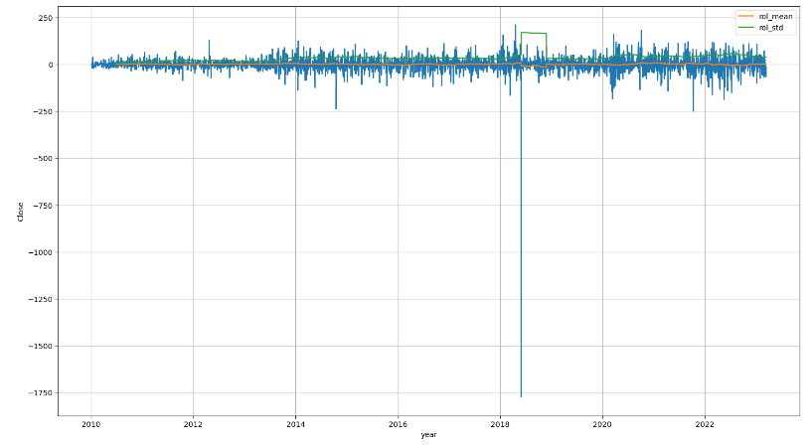
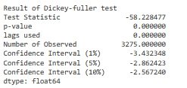
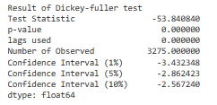
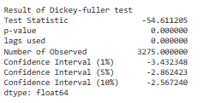
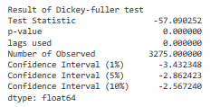
DIFFERENCING
By differencing the data for Open,High,Low,Close,
We found the p-value less than 0.05.Hence data is stationary.
We cross verified by plotting it.

Slide 26
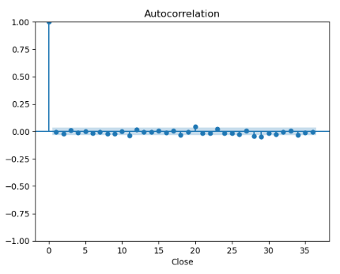
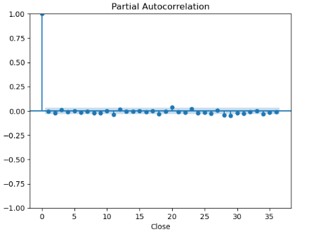
ACF & PACF FOR STATIONARY DATA(Close)
We found that 0 correlation(weak) at all lag points Except 0 lag.
We found that 0 correlation(weak) at all lag points Except 0 lag.

Slide 27
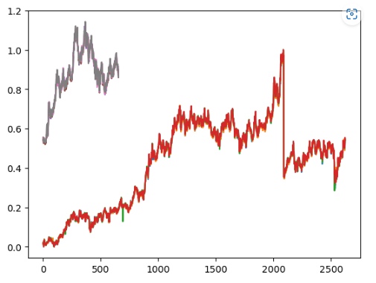
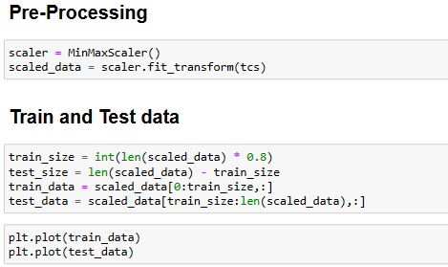
MIN MAX SCALER
After MinMaxScaler we are Plotting Train and Test data.

Slide 28
MODEL BUILDING
We uses different models for model building for best accuracy.
Different Models are:
Autoregressive Integrated Moving Average (ARIMA)
Seasonal Autoregressive Integrated Moving-Average (SARIMA)
Seasonal Autoregressive Integrated Moving-Average with Exogenous Regressors (SARIMAX)
Simple Exponential Smoothing (SES)
Holt Winter’s Exponential Smoothing (HWES)

Slide 29
LSTM
LSTM (Long Short-Term Memory) is a type of artificial neural network that is particularly well-suited for sequential data, such as time series or natural language processing.
Advantages:
Can handle sequential data with long-term dependencies.
Ability to selectively remember or forget previous inputs and outputs.
Can handle missing data.
Can be used to model both linear and non-linear relationships between variables.
Disadvantages:
Computationally expensive to train.
Sensitive to the choice of hyperparameters.
Can suffer from overfitting if the model is too complex.
May not be suitable for tasks that require real-time processing.

Slide 30
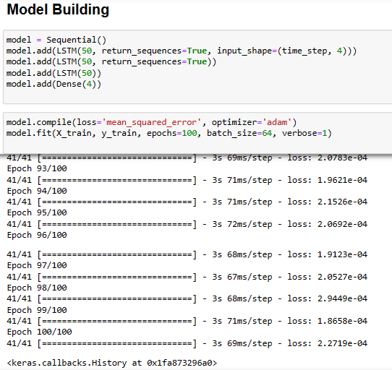
LSTM MODEL
We are building the LSTM Model with loss function as mean_squared_error and optimizer as adam.

Slide 31
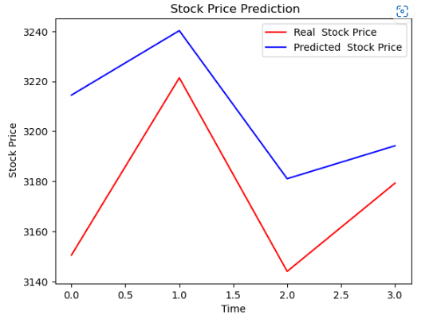
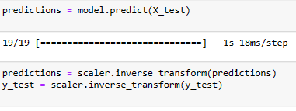

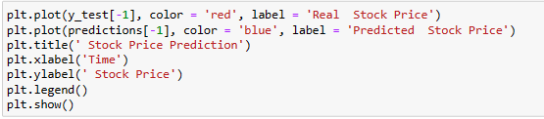
PREDICTING
We are Plotting Actual and Predicted value of stock price of close.

Slide 32
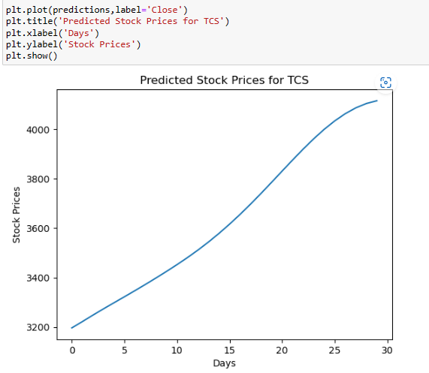

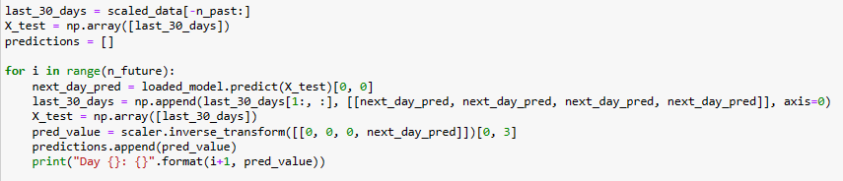
FORECASTING FOR 30 DAYS
We are Forecasting the stock price of close for 30days.

Slide 33
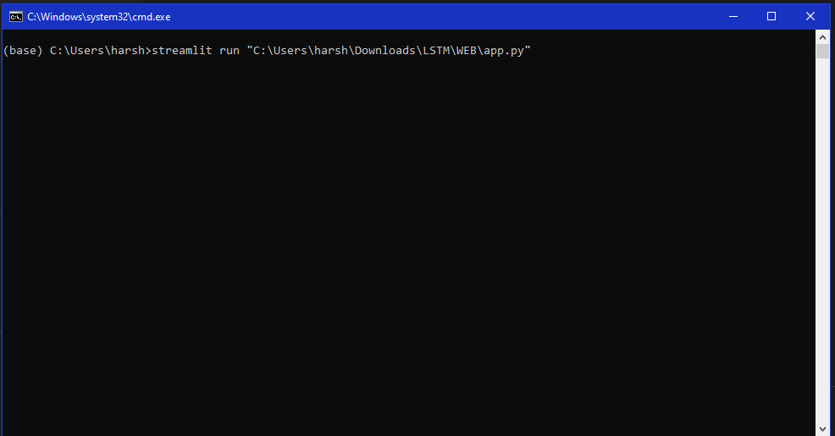
DEPLOYMENT
Enter streamlit run and path of file.
Press enter.

Slide 34
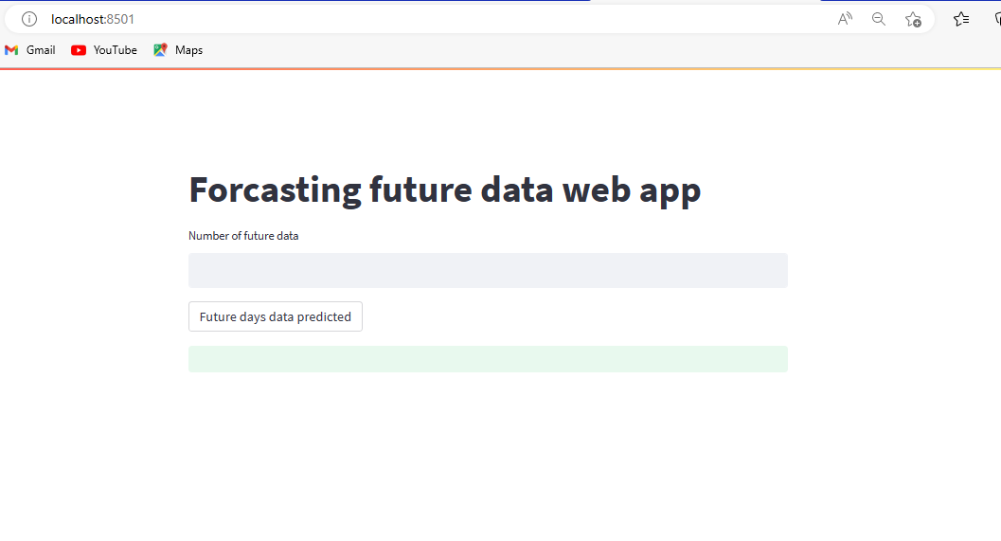
DEPLOYMENT
New screen will be opened.

Slide 35
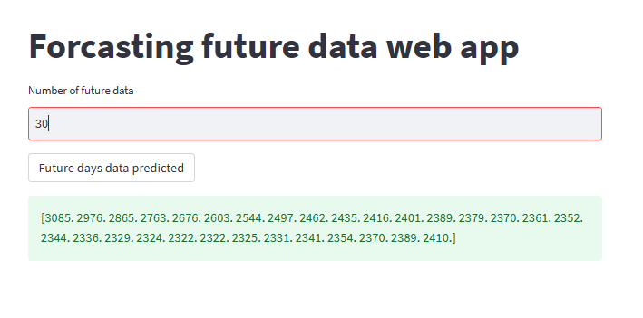
DEPLOYMENT
Enter the number of days to be forcasted and click on predict button.

Slide 36
THANK YOU

